Slide 1


WEB TECHNOLOGY
Target-3
Recipe Sharing Website
Batch-17

Slide 2






Batch Members:
Shanmukha Sudha Kiran . T - 211 FA 04003 Ravi Kiran. K- 211 FA 04043
Deepthi . U - 211 FA 04046
sahil RAJ - 211 FA 04677
R e c i p e s h a r i n g w e b s i t e
WATCH NOW

Slide 3

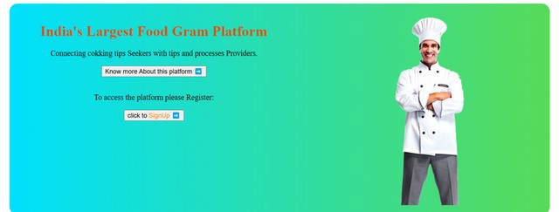
index.php
<!DOCTYPE html>
<head>
<title>Home page</title>
<link href="navigation.css" rel="stylesheet">
</head>
<body>
<nav class="navbar" ><div class="logo">
<a href="index.jsp"><kk style="color: pink;">Food</kk> <span
style="color: green;">Gram</span></a>
</div>
<ul class="nav-links">
<li><a href="index.html">Home</a></li>
<li><a href="about.html">About</a></li>
<!--add required one-->
<script>
</ul>
let slideIndex = 0;
</nav>
<div class="background">
showSlides();
<div class="slideshow-container" style="margin-top: 50px;">
function showSlides() {
<div class="mySlides fade">
<img src="photos/p1img5.jpg" style="width:80%">
let i;
let slides = document.getElementsByClassName("mySlides");
</div>
let dots = document.getElementsByClassName("dot");
<div class="mySlides fade">
<img src="photos/p1img1.jpg" style="width:80%"></div>
for (i = 0; i < slides.length; i++) {
</div><div class="text" style="display: flex;flex-direction: row; justify-
slides[i].style.display = "none";
content: center;text-align: center;margin-left: 90px;" >
<div>
}
<h1>India's Largest Food Gram Platform</h1>
slideIndex++;
<p>Connecting cokking tips Seekers with tips and processes Providers.</p>
if (slideIndex > slides.length) {slideIndex = 1}
<button id="but" type="submit">Know more About this platform ➡</button>
for (i = 0; i < dots.length; i++) {
<br><br>
dots[i].className = dots[i].className.replace(" active",
<p>To access the platform please Register:</p>
<button id="sign" type="submit">click to <spa style="color:
"");
darkorange">SignUp</spa> ➡</button><br>
}
</div>
slides[slideIndex-1].style.display = "block";
<div><img src="photos/chef.png"></div></div>
dots[slideIndex-1].className += " active";
setTimeout(showSlides, 1000); // Change image every 2
seconds
}
</script></body></html>

Slide 4

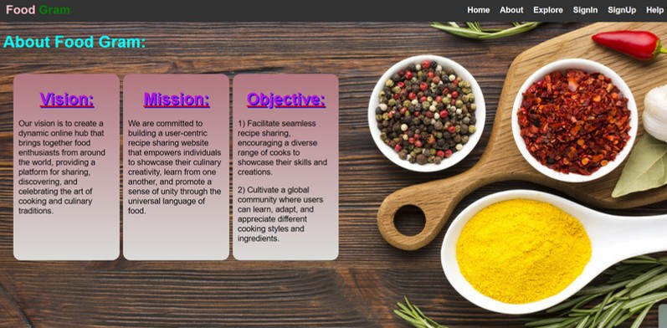

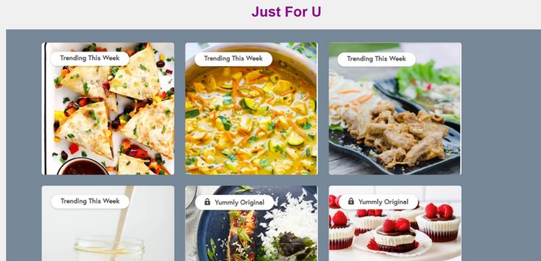
About.php
<html lang="en">
<head>
<title>Navigation Bar</title>
<link href="navigation.css" rel="stylesheet">
<link href='dropdown.css' rel='stylesheet'>
<!-- <style>add required styles</style> -->
</head>
<body>
<nav class="navbar">
<div class="logo">
<a href="p1.html"><kk style="color: pink;">Food</kk>
<span style="color: green;">Gram</span></a>
</div>
<ul class="nav-links">
<li><a href="index.html">Home</a></li>
<li><a href="about.html">About</a></li>
<!--add required navigation lines-->
</ul>
</nav>
<div>
<h1 style="margin-left: 15px; color:cyan;">About Food Gram:</h1>
</div>
<div class="a">
<div><h1>Vision:</h1>
<p>Our vision is to create a dynamic online hub that brings together food enthusiasts from around the world, providing a platform for sharing, discovering, and celebrating the art of cooking and culinary traditions.</p>
</div>
<div><h1>Mission:</h1>
<p>We are committed to building a user-centric recipe sharing website that empowers individuals to showcase their culinary creativity, learn from one another, and promote a sense of unity through the universal language of food.</p></div>
<div><h1>Objective:</h1>
<p>1) Facilitate seamless recipe sharing, encouraging a diverse range of cooks to showcase their skills and creations.</p>
<p>2) Cultivate a global community where users can learn, adapt, and appreciate different cooking styles and ingredients.</p></div></div>
<div style=" margin-left: 55px; margin-top: 199px; text-align: center;">
<h1 style="color:darkmagenta;text-shadow: 2px 2px 2px 2px;">Just For U</h1>
</div>
<div class="justforu">
<a href="signup.html"><img src="just/just1.png" alt="Click me" height="300px" width="300px"></a>
<a href="signup.html"><img src="just/just2.png" alt="Click me" height="300px" width="300px"></a>
</div></body>
</html>

Slide 5




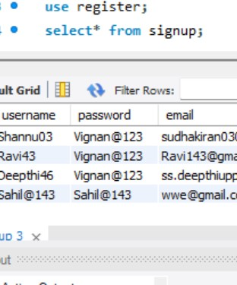
Signupform.php
Signup. php
?php session_start(); (isset($_SESSION[''username''])) {
<?php
$username = $_POST["username"];
$password = $_POST["password"];
$email = $_POST["email"]; try {
$conn = new mysqli("localhost", "root", "root", "register"); if ($conn->connect_error) {
die("Connection failed: " . $conn->connect_error);}
$stmt = $conn->prepare("INSERT INTO signup (username, password, email) VALUES (?, ?, ?)");
$stmt->bind_param("sss", $username, $password, $email); if ($stmt->execute()) {
session_start();
$_SESSION['username'] = $username; header("Location: inner.php");
exit();
} else {
echo "<html><body>";echo "<script>"; echo "alert('Registration failed');";
echo "window.location.href = 'signup.html';"; echo "</script>";echo "</body></html>";
}
$stmt->close();$conn->close();
} catch (Exception $e) { echo $e->getMessage();}
?>
header("Location: inner.php");
exit;}
>
html lang="en"> head>
<script src="https://ajax.googleapis.com/ajax/libs/angularjs/1.6.9/angular.min.js"></script>
<title>Sign Up and Sign In</title>
/head> body>
<div class="container" ng-app="myApp" ng-controller="UserController">
<div class="form-container">
<h1>Sign Up</h1>
<form ng-submit="submitForm()" id="myForm" action="signupDB.php" method="post">
<input type="text" name="username" placeholder="Username" ng-model="name" ng- odel-options="{ updateOn: ''default blur'', debounce: { default: 300, blur: 0 } }" ng-
hange="validateName()" required>
<span style="color: red;" ng-show="error1">{{error1}}</span><br>
<input type="password" name="password" placeholder="Password" ng-model="password"
g-model-options="{ updateOn: ''default blur'', debounce: { default: 300, blur: 0 } }" ng-
hange="validatePassword()" required><br>
<span style="color: red;" ng-show="error2">{{error2}}</span><br>
<input type="email" name="email" placeholder="Email" ng-model="email" ng-model-
ptions="{ updateOn: ''default blur'', debounce: { default: 300, blur: 0 } }" ng-
hange="validateEmail()" required><br>
<span style="color: red;" ng-show="error3">{{error3}}</span><br>
<button type="submit" id="sub">Sign Up</button><br> already have an account? <a href="signin.php">Login</a>
</form>
</div>
</div>
<script src="signup.js"></script>
<?php if (isset($login_error)) {
echo "<p>$login_error</p>";
} ?>
/body>
/html>

Slide 6


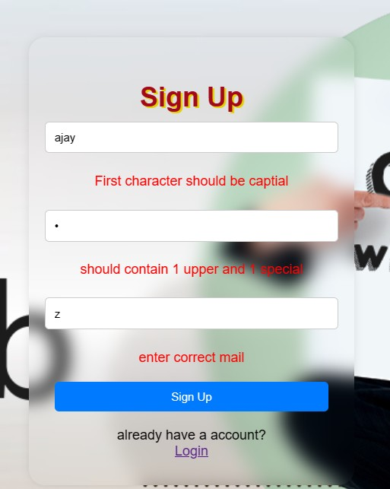
Signup. js
var app = angular.module('myApp', []); app.controller('UserController', function($scope) {
$scope.error1 = "";
$scope.error2 = "";
$scope.error3 = "";
$scope.validateName = function() {
$scope.error1 = "First character should be capital"; if ($scope.name.length === 0) {
$scope.error1 = "";
} else if ($scope.name[0] >= 'A' && $scope.name[0] <= 'Z') { var flag = 0;
for (var i = 0; i < $scope.name.length; i++) {
if ($scope.name[i] >= '0' && $scope.name[i] <= '9') {
$scope.error1 = ""; flag = 1;
} else if (flag === 1) {
$scope.error1 = "";
} else {
$scope.error1 = "Username should contain at least one digit";}}
} else {
$scope.error1 = "First character should be capital";}};
$scope.validatePassword = function() {
var specialCharacters = "!@#$%^&*()_+{}[]:;<>,.?~\\/-=";
$scope.error2 = "";
if ($scope.password.length === 0) {
$scope.error2 = "";
} else {
var f1 = 0, f2 = 0, f3 = 0;
for (var i = 0; i < $scope.password.length; i++) {
if (($scope.password[i] >= 'A' && $scope.password[i] <= 'Z')) { f1 = 1;
} else if (($scope.password[i] >= 'a' && $scope.password[i] <= 'z')) { f2 = 1;
} else if (specialCharacters.indexOf($scope.password[i]) !== -1) { f3 = 1;
} else {
$scope.error2 = "";}
if (f1 === 1 && f2 === 1 && f3 === 1) {
$scope.error2 = "";
} else if (f2 === 1) {
$scope.error2 = "Should contain 1 uppercase and 1 special";
} else if (f3 === 1) {
$scope.error2 = "Should contain 1 lowercase and 1 uppercase";
} else {
$scope.error2 = "Should contain 1 uppercase letter, 1 lowercase letter, and 1 special character";
}}}};
$scope.validateEmail = function() {
$scope.error3 = "";
if ($scope.email === "") {
$scope.error3 = "";
} else {
var pattern = /^[a-zA-Z0-9._%+-]+@[a-zA-Z0-9.-]+\.[a-zA-Z]+$/; if (pattern.test($scope.email)) {
$scope.error3 = "";
} else {
$scope.error3 = "Enter correct email";}}};
$scope.redirectToIndex = function() { window.location.href = "index.html";};
$scope.redirectToHome = function() {
// Replace with the desired URL window.location.href = "index.html";};});

Slide 7

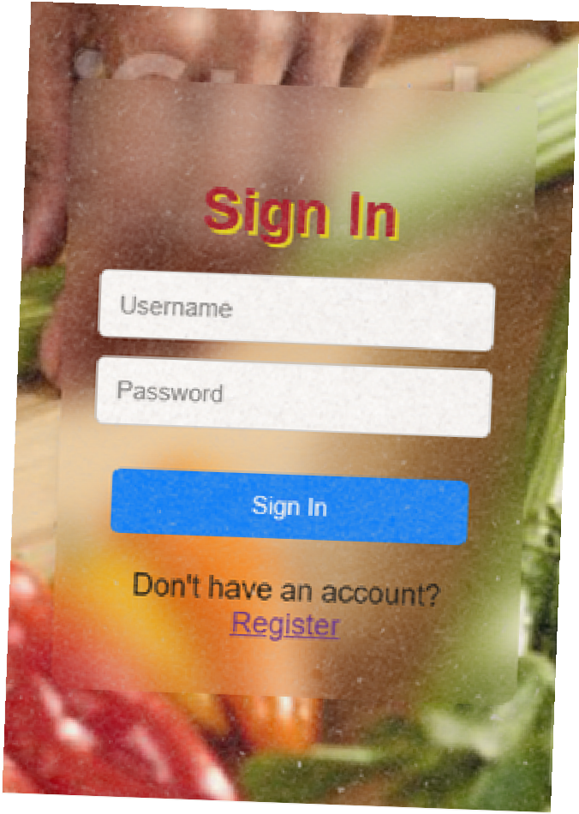



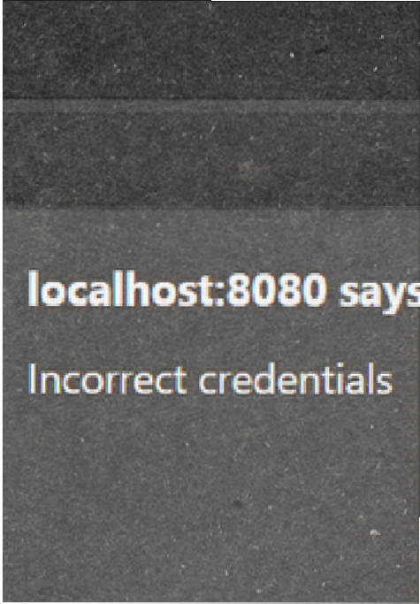
Signin. php
SigninDB.php
<?php session_start();
if (isset($_SESSION['username'])) { header("Location: inner.php"); exit;
}
$login_error = "";
?>
<html lang="en">
<head>
<title>Sign In</title>
</head>
<body>
<div class="container">
<div class="form-container">
<h1>Sign In</h1>
<form action="signinDB.php" method="post" id="myForm">
<input type="text" name="username" placeholder="Username" required>
<input type="password" name="password" placeholder="Password" required><br>
<button type="submit">Sign In</button><br>
Don't have an account? <a href="signupform.php">Register</a>
</form></div></div>
<script> document.getElementById("logo").addEventListener("click",
function() { window.location.href = "index.php"; // Replace with the
desired URL});
</script>
<?php if (isset($login_error)) {
echo "<p>$login_error</p>";}?>
</body>
</html>
<?php if ($_SERVER['REQUEST_METHOD'] === 'POST') {
$enteredUsername = $_POST["username"];
$enteredPassword = $_POST["password"];
$conn = new mysqli("localhost", "root", "root", "register");
if ($conn->connect_error) {
die("Connection failed: " . $conn-
>connect_error);
}
$stmt = $conn->prepare("SELECT * FROM signup WHERE username=? AND password=?");
$stmt->bind_param("ss",
$enteredUsername, $enteredPassword);
$stmt->execute();
$result = $stmt->get_result(); if ($result->num_rows > 0) { session_start();
$_SESSION['username'] =
$enteredUsername;
$stmt->close();
$conn->close(); header("Location: inner.php"); exit();
} else {
echo "<script>alert('Incorrect credentials'); window.location.href = 'signin.php';</script>";
}
} else { echo "Invalid request.";
}
?>

Slide 8

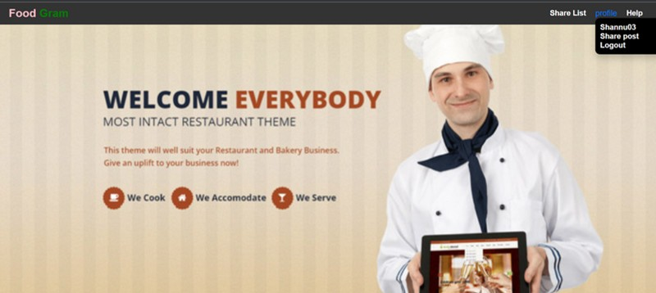
Inner. php
<?php
session_start();
?>
<!DOCTYPE html>
<html lang="en">
<head>
<meta charset="UTF-8">
<meta name="viewport" content="width=device-width, initial-scale=1.0">
<title>Navigation Bar</title>
</head>
<body>
<nav class="navbar">
<div class="logo">
<a href="index.php"><kk style="color: pink;">Food</kk> <span style="color
green;">Gram</span></a>
</div>
<ul class="nav-links">
<li><a href="retrive.php">Share List</a></li>
<li>
<div class="dropdown">
<a href="#" class="dropbtn">profile</a>
<div class="dropdown-content">
<a href="aboutme.php"> <?php if(isset($_SESSION['username'])) { echo $_SESSION['username'];}?>
</a><br>
<a href="addpost.php">Share post</a><br>
<a href="logout.php">Logout</a><br>
</div></div>
</li>
<li><a href="help2.php">Help</a></li></ul></nav>
</body>
</html>
:

Slide 9
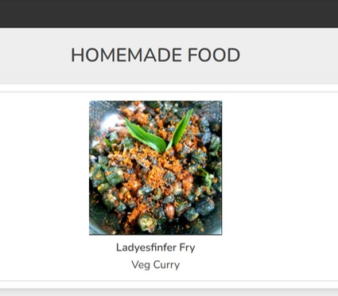


veg.php
<section class="menu">
<?php session_start(); // Start the session
if (isset($_SESSION['username'])) {
$servername = 'localhost';
$username = 'root';$password = 'root';$database = 'register';
$conn = mysqli_connect($servername, $username, $password, $database); if (!$conn) {
die("Error in DB connection: " . mysqli_connect_errno() . " : " . mysqli_connect_error());}
$user_id = $_SESSION['username']; // Retrieve the user's ID from the session
// Check if a file has been deleted
if (isset($_GET['deleted']) && $_GET['deleted'] === 'true') { echo '<p>File has been deleted.</p>';}
$query = "SELECT * FROM sharepost WHERE username = '$user_id' and recipe_type='Veg
Curry' ";
$result = mysqli_query($conn, $query); echo '<html>';echo '<head>';
echo '<link rel="stylesheet" type="text/css" href="your_css_file.css">'; // Link your CSS file echo '</head>';echo '<body>';
if (mysqli_num_rows($result) > 0) { while ($row = mysqli_fetch_assoc($result)) {
$file_name = $row['file_name'];$shareby = $row['shareby'];
$recipe_name = $row['recipe_name'];$recipe_type = $row['recipe_type'];$file_description =
$row['recipe_description'];
echo '<div class="menu-item">';
echo '<p><strong>Share by:</strong> ' . $shareby . '</p>';
echo '<img src="upload/' . $file_name . '" alt="' . $file_description . '">'; echo '<h2><strong>Name of Recipe:</strong> ' . $recipe_name . '</h2>'; echo '<h2><strong>Type of Recipe:</strong> ' . $recipe_type . '</h2>'; echo '<p><strong>About Recipe:</strong> ' . $file_description . '</p>'; echo '</form>';echo '</div>';
}} else {
echo '<p>No images are present.</p>';
}
echo '</body>'; echo '</html>'; mysqli_close($conn);
} else {
echo 'You are not logged in. Please log in to access this page.';}
?>
</section>

Slide 10
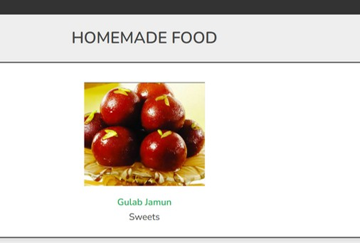

sweets.php
<section class="menu">
<?php session_start(); // Start the session
if (isset($_SESSION['username'])) {
$servername = 'localhost';
$username = 'root';$password = 'root';$database = 'register';
$conn = mysqli_connect($servername, $username, $password, $database); if (!$conn) {
die("Error in DB connection: " . mysqli_connect_errno() . " : " . mysqli_connect_error());}
$user_id = $_SESSION['username']; // Retrieve the user's ID from the session
// Check if a file has been deleted
if (isset($_GET['deleted']) && $_GET['deleted'] === 'true') { echo '<p>File has been deleted.</p>';}
$query = "SELECT * FROM sharepost WHERE username = '$user_id' and recipe_type='sweet_item' ";
$result = mysqli_query($conn, $query); echo '<html>';echo '<head>';
echo '<link rel="stylesheet" type="text/css" href="your_css_file.css">'; // Link your CSS file echo '</head>';echo '<body>';
if (mysqli_num_rows($result) > 0) { while ($row = mysqli_fetch_assoc($result)) {
$file_name = $row['file_name'];$shareby = $row['shareby'];
$recipe_name = $row['recipe_name'];$recipe_type = $row['recipe_type'];$file_description =
$row['recipe_description'];
echo '<div class="menu-item">';
echo '<p><strong>Share by:</strong> ' . $shareby . '</p>';
echo '<img src="upload/' . $file_name . '" alt="' . $file_description . '">'; echo '<h2><strong>Name of Recipe:</strong> ' . $recipe_name . '</h2>'; echo '<h2><strong>Type of Recipe:</strong> ' . $recipe_type . '</h2>'; echo '<p><strong>About Recipe:</strong> ' . $file_description . '</p>'; echo '</form>';echo '</div>';
}} else {
echo '<p>No images are present.</p>';
}
echo '</body>'; echo '</html>'; mysqli_close($conn);
} else {
echo 'You are not logged in. Please log in to access this page.';}
?>
</section>

Slide 11
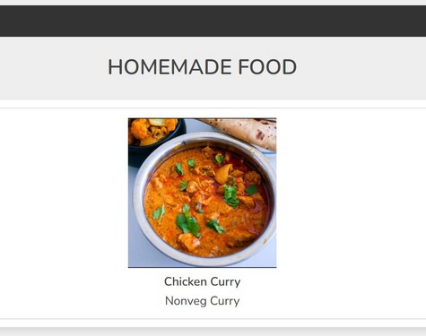

nonveg.php
<section class="menu">
<?php session_start(); // Start the session
if (isset($_SESSION['username'])) {
$servername = 'localhost';
$username = 'root';$password = 'root';$database = 'register';
$conn = mysqli_connect($servername, $username, $password, $database); if (!$conn) {
die("Error in DB connection: " . mysqli_connect_errno() . " : " . mysqli_connect_error());}
$user_id = $_SESSION['username']; // Retrieve the user's ID from the session
// Check if a file has been deleted
if (isset($_GET['deleted']) && $_GET['deleted'] === 'true') { echo '<p>File has been deleted.</p>';}
$query = "SELECT * FROM sharepost WHERE username = '$user_id' and recipe_type='nonveg
Curry' ";
$result = mysqli_query($conn, $query); echo '<html>';echo '<head>';
echo '<link rel="stylesheet" type="text/css" href="your_css_file.css">'; // Link your CSS file echo '</head>';echo '<body>';
if (mysqli_num_rows($result) > 0) { while ($row = mysqli_fetch_assoc($result)) {
$file_name = $row['file_name'];$shareby = $row['shareby'];
$recipe_name = $row['recipe_name'];$recipe_type = $row['recipe_type'];$file_description =
$row['recipe_description'];
echo '<div class="menu-item">';
echo '<p><strong>Share by:</strong> ' . $shareby . '</p>';
echo '<img src="upload/' . $file_name . '" alt="' . $file_description . '">'; echo '<h2><strong>Name of Recipe:</strong> ' . $recipe_name . '</h2>'; echo '<h2><strong>Type of Recipe:</strong> ' . $recipe_type . '</h2>'; echo '<p><strong>About Recipe:</strong> ' . $file_description . '</p>'; echo '</form>';echo '</div>';
}} else {
echo '<p>No images are present.</p>';
}
echo '</body>'; echo '</html>'; mysqli_close($conn);
} else {
echo 'You are not logged in. Please log in to access this page.';}
?>
</section>

Slide 12
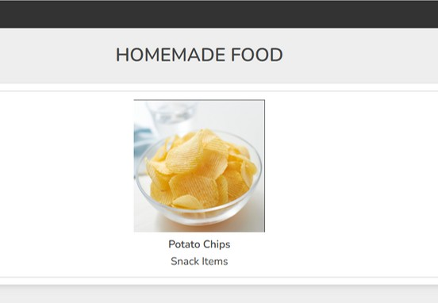
snack_item.html
<html lang="en">
<head>
<link rel="stylesheet" href="explore.css">
<link href="navigation.css" rel="stylesheet">
</head>
<body>
<div class="container">
<nav class="navbar" >
<div class="logo">
<a href="index.html"><kk style="color: pink;">Food</kk> <span style="color: green;">Gram</span></a></div>
<ul class="nav-links"><li><a href="inner.html">Back</a></li></ul>
</nav><br><br>
<h3 class="title"> Homemade Food </h3>
<div class="products-container">
<div class="product" data-name="p-2">
<img src="snack_items/chips1.png" alt="">
<h3>Potato chips</h3>
<div class="price">Snack Items</div>
</div> </div></div>
<div class="products-preview">
<div class="preview" data-target="p-2">
<i class="fas fa-times"></i>
<img src="snack_items/chips2.png" alt="">
<h3>Potato Chips</h3>
<div class="buttons">
<a href="snack_items.html" class="buy">back</a>
<a href="#" class="cart">add to wishlist</a>
</div></div></div>
<script>
let preveiwContainer = document.querySelector('.products-preview'); let previewBox = preveiwContainer.querySelectorAll('.preview');
document.querySelectorAll('.products-container .product').forEach(product =>{ product.onclick = () =>{
preveiwContainer.style.display = 'flex';
let name = product.getAttribute('data-name'); previewBox.forEach(preview =>{
let target = preview.getAttribute('data-target'); if(name === target){ preview.classList.add('active');
}});};});
previewBox.forEach(close =>{ close.querySelector('.fa-times').onclick = () =>{ close.classList.remove('active'); preveiwContainer.style.display = 'none'; };});
</script></body>
</html>

Slide 13
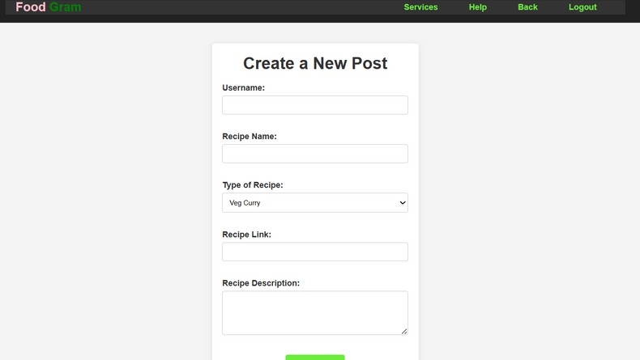
Addpost.php
FAUGET
<div class="container">
<h1>Share Post</h1>
<form action="upload.php" method="post" enctype="multipart/form-data" id="acting" >
<label for="username">Username:</label>
<select id="username" name="username" required>
<option value="">Select a state</option>
<?php
$conn = mysqli_connect("localhost", "root", "root",
"register");
if (!$conn) {
die("Connection failed: " . mysqli_connect_error());}
$query = "SELECT * FROM signup";
$result = mysqli_query($conn, $query); while ($row = mysqli_fetch_assoc($result)) {
echo "<option value='" . $row['username'] . "'>" .
$row['username'] . "</option>";} mysqli_close($conn);
?>
</select><br>
<label for="recipe-name">Recipe Name:</label>
<input type="text" id="recipe-name" name="recipe-
Curry</option>
<option value="Sweets">Sweets</option>
<option value="Bakery Items">Bakery Items</option>
<option value="Snack Item">Snack Item</option>
</select><br><br>
<label for="recipe-photo">Recipe Photo:
</label>
<input type="file" name="recipe-photo" id="recipe-photo" required>
<label for="recipe-description">Recipe Description:(Within 5 - 8 words) </label>
<textarea id="recipe-description" name="recipe- description" rows="4" required></textarea><br>
<br>
<button type="submit">Share Post</button>
</form>
</div>
name" required><br><br>
<label for="type">Type of Recipe:</label>
<select id="type" name="type">
<opt value="Veg Curry">Veg Curry</option>
ion
<option value="Nonveg Curry">NonVeg

Slide 14


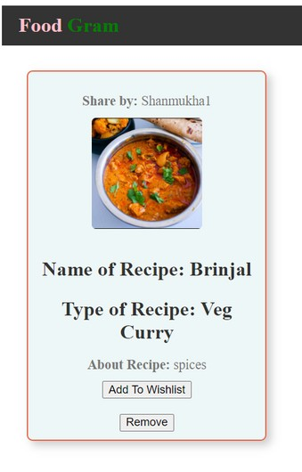
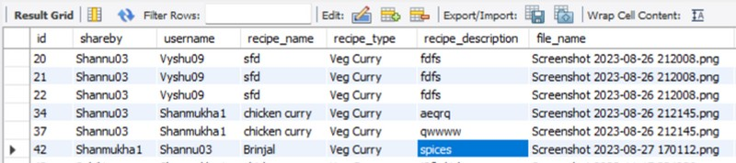
retrive.php
<!DOCTYPE html>
<html lang="en">
<head>
<title>Menu - Restaurant Name</title>
</head>
<body>
<section class="menu">
<?php session_start(); // Start the session if (isset($_SESSION['username'])) {
$servername = 'localhost';
$username = 'root';
$password = 'root';
$database = 'register';
$conn = mysqli_connect($servername, $username, $password, $database);
$query = "SELECT * FROM sharepost WHERE username = '$user_id' ";
$result = mysqli_query($conn, $query); echo '<html>';
echo '<head>';
echo '<link rel="stylesheet" type="text/css" href="your_css_file.css">'; //
Link your CSS file echo '</head>'; echo '<body>';
if (mysqli_num_rows($result) > 0) { while ($row = mysqli_fetch_assoc($result)) {
$file_name = $row['file_name'];
$shareby = $row['shareby'];
$recipe_name = $row['recipe_name'];
$recipe_type = $row['recipe_type'];
$file_description = $row['recipe_description']; echo '<div class="menu-item">';
echo '<p><strong>Share by:</strong> ' . $shareby . '</p>';
echo '<img src="upload/' . $file_name . '" alt="' . $file_description . '">'; echo '<h2><strong>Name of Recipe:</strong> ' . $recipe_name .
'</h2>';
echo '<h2><strong>Type of Recipe:</strong> ' . $recipe_type . '</h2>';
echo '<p><strong>About Recipe:</strong> ' . $file_description . '</p>';
$file_id = $row['id'];
?>
<form action="wishlistdb.php" method="post">
<button name="addToCart">Add To Wishlist</button>
</form><br>
<form action="delete.php" method="post">
<button name="removeCart">Remove</button>
</form>
<?php echo '</div>';
n);
} else {
echo 'You are not logged in. Please log in to access this page.';
}
?>
</section>
</body>
</html>

Slide 15
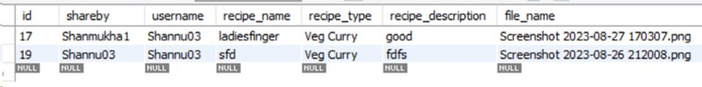
wishlistdb.php
<?php
$servername = "localhost";
$username = "root";
$password = "root";
$database = "register";
$conn = new mysqli($servername, $username, $password, $database); if (isset($_POST['addToCart'])) {
session_start();
$session=$_SESSION['username']; echo "$session";
$recipeType = $_POST['recipe_type'];
$recipeDescription = $_POST['recipe_description'];
$userName = "$session";
$filename = $_POST['file_name'];
$sql = "INSERT INTO wishlist (shareby, username, recipe_name, recipe_type, recipe_description, file_name, uploaded_on) "
. "VALUES ('$shareby', '$userName', '$recipeName', '$recipeType', '$recipeDescription', '$filename', NOW())"; if (mysqli_query($conn, $sql)) {
echo '</script>';
} else {
echo "Error adding record: " . mysqli_error($conn);}} if (isset($_POST['removeCart'])) {
session_start();
$session=$_SESSION['username'];
$recipeType = $_POST['recipe_type'];
$recipeDescription = $_POST['recipe_description'];
$recipeName = $_POST['recipe_name'];
$shareby = $_POST['shareby'];
$filename = $_POST['file_name'];
$sql = "DELETE FROM wishlist WHERE shareby = '$shareby' and username = '$userName' and file_name='$filename'";
if ($conn->query($sql) === TRUE) echo 'alert("Item deleted from Wishlist!");';
else
echo "Error deleting row: " . $conn->error;}?>
echo '<script type="text/javascript">'; echo 'alert("Item added to bag!");';
echo 'window.history.back();'; // Redirect to previous_page

Slide 16
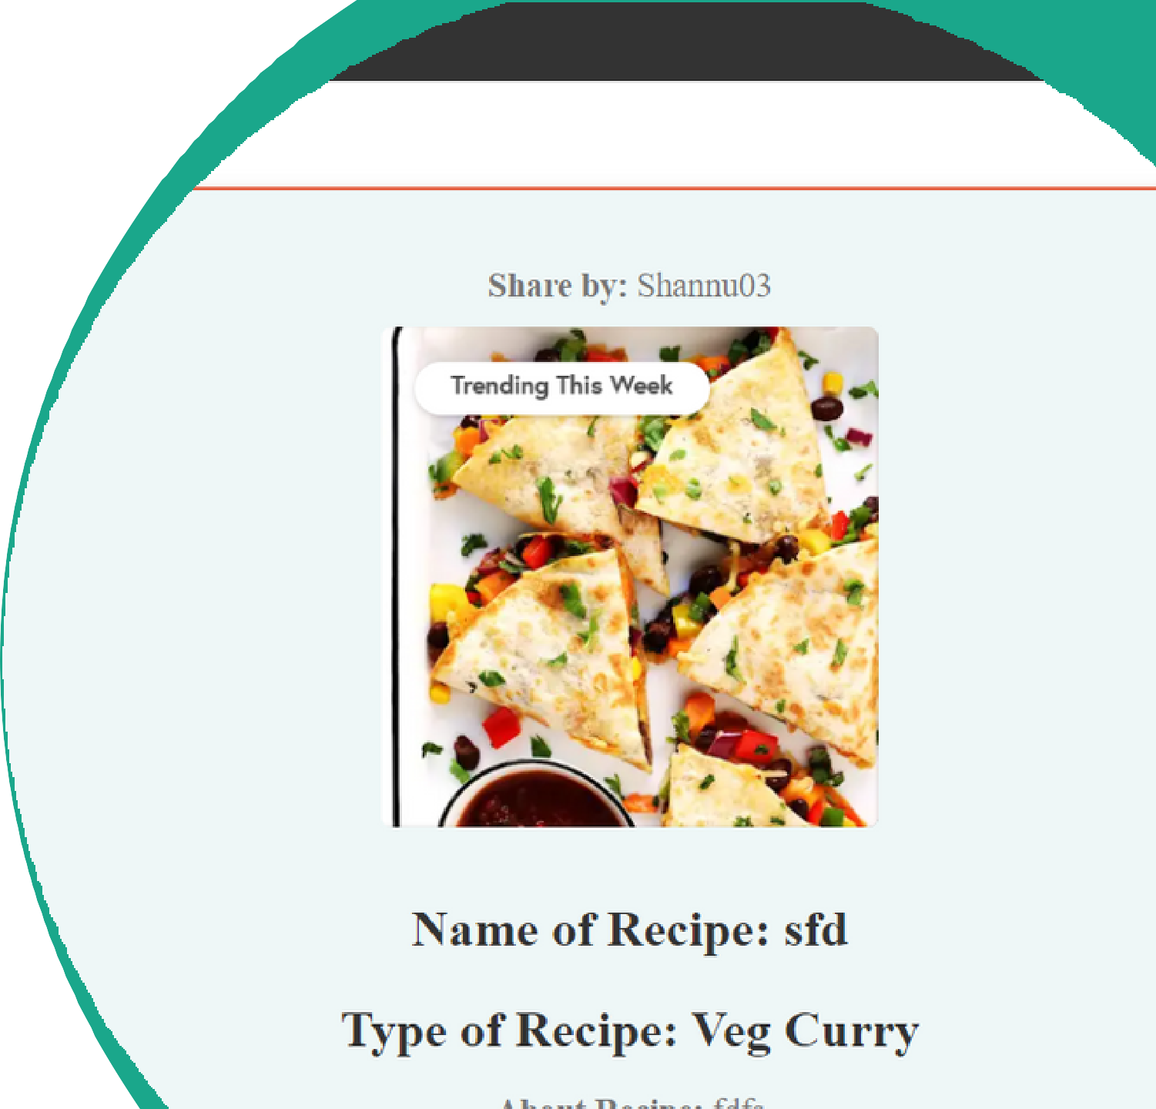
Wishlist.php
<!DOCTYPE HTML>
<HTML LANG="EN">
<BODY>
<SECTION CLASS="MENU">
<?PHP
SESSION_START(); // START THE SESSION IF (ISSET($_SESSION['USERNAME'])) {
$SERVERNAME = 'LOCALHOST';
$USERNAME = 'ROOT';
$PASSWORD = 'ROOT';
$DATABASE = 'REGISTER';
$CONN = MYSQLI_CONNECT($SERVERNAME, $USERNAME,
$PASSWORD, $DATABASE);
$QUERY = "SELECT * FROM WISHLIST WHERE USERNAME = '$USER_ID'
";
$RESULT = MYSQLI_QUERY($CONN, $QUERY); ECHO '<HTML>';
ECHO '<HEAD>';
ECHO '<LINK REL="STYLESHEET" TYPE="TEXT/CSS" HREF="YOUR_CSS_FILE.CSS">'; // LINK YOUR CSS FILE
ECHO '</HEAD>';ECHO '<BODY>';
IF (MYSQLI_NUM_ROWS($RESULT) > 0) {
WHILE ($ROW = MYSQLI_FETCH_ASSOC($RESULT)) {
$FILE_NAME = $ROW['FILE_NAME'];
$SHAREBY = $ROW['SHAREBY'];
$FILE_DESCRIPTION = $ROW['RECIPE_DESCRIPTION']; ECHO '<DIV CLASS="MENU-ITEM">';
ECHO '<P><STRONG>SHARE BY:</STRONG> ' . $SHAREBY . '</P>'; ECHO '<IMG SRC="UPLOAD/' . $FILE_NAME . '" ALT="' .
$FILE_DESCRIPTION . '">';
ECHO '<H2><STRONG>NAME OF RECIPE:</STRONG> ' . $RECIPE_NAME
. '</H2>';
ECHO '<P><STRONG>PRICE RECIPE= 50 :</STRONG> ' .
$FILE_DESCRIPTION . '</P>';
$FILE_ID = $ROW['ID']; ?>
<FORM ACTION="WISHLISTDB.PHP" METHOD="POST">
<BUTTON NAME="REMOVECART">REMOVE</BUTTON>
</FORM><?PHP }?></SECTION>
</BODY>
</HTML>

Slide 17


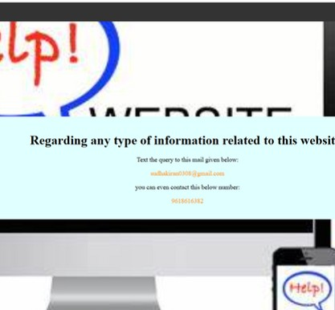
help.php
<html lang="en">
<head>
<title>Help</title>
<link rel="stylesheet" href="navigation.css">
</head>
<body>
<div class="main">
<nav class="navbar" >
<div class="logo">
<a href="index.html"><kk style="color: pink;">Food</kk>
<span style="color: green;">Gram</span></a></div>
<ul class="nav-links">
<li><a href="index.html">Home</a></li>
<li><a href="about.html">About</a></li></ul>
</nav>
<center>
<div class="text" >
<h1>Regarding any type of information related to this website:</h1>
<p>Text the query to this mail given below:</p>
<p><spa style="color:darkorange">sudhakiran0308@gmail.com
</spa></p>
<p>you can even contact this below number:</p>
<p> <spa style="color: darkorange">9618616382</spa><p>
</div>
</center></div>
</body>
</html>

Slide 18

GROM : GROUP-17

